Slide 1
XYZ WHITSUNDAY RESORT
EXPANDING INTO THE FUTURE ONE DAY AT A TIME

Slide 2
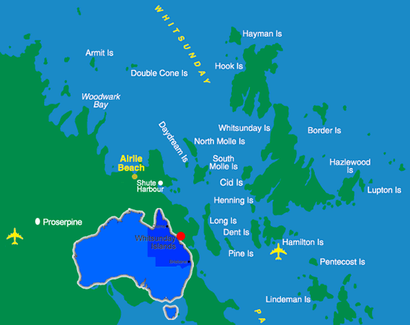

Slide 3
* How did we get here
& What makes us great?
* Where do we go from here?

Slide 4
Skills and labour shortages

Slide 5
requirments for a diverse workforce e.g. workers background including cultural and linguistic backgrounds

Slide 6
Objectives
- becoming an employer of choice
- how do we increase our middle eastern cliental?

Slide 7
In conclusion

